Slide 1
CS1231 Tutorial 4
AY18/19 – WEEK 6
Andrew Tan

Slide 2
More Number Theory!
1. Well Ordering Principle
2. Greatest Common Divisor
3. Modulo Arithmetic

Slide 3
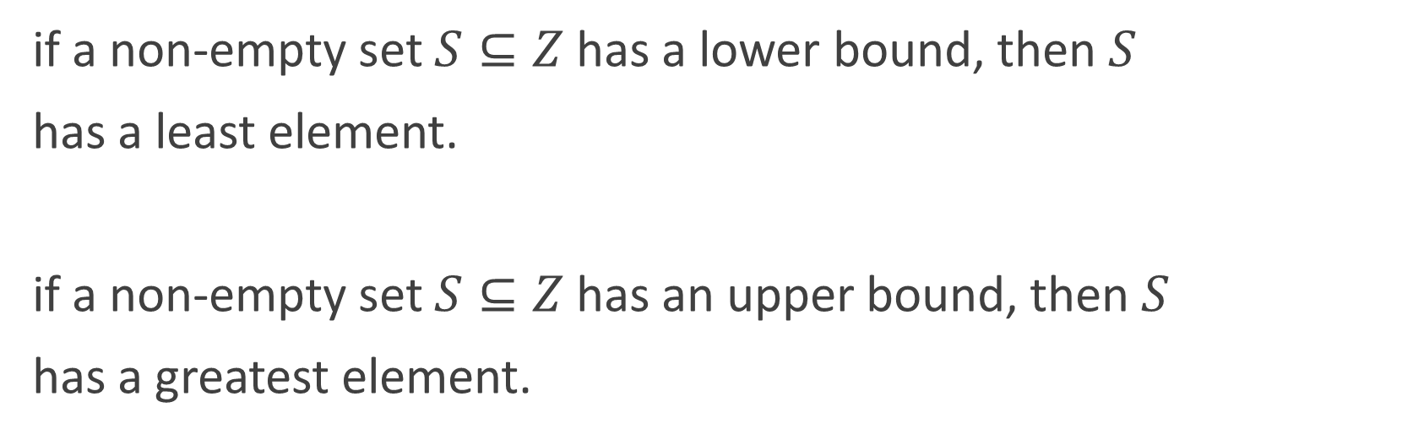
Well Ordering Principle
if a non-empty set $S⊆Z$has a lower bound, then$S$
has a least element.
if a non-empty set $S⊆Z$has an upper bound, then$S$
has a greatest element.

Slide 4
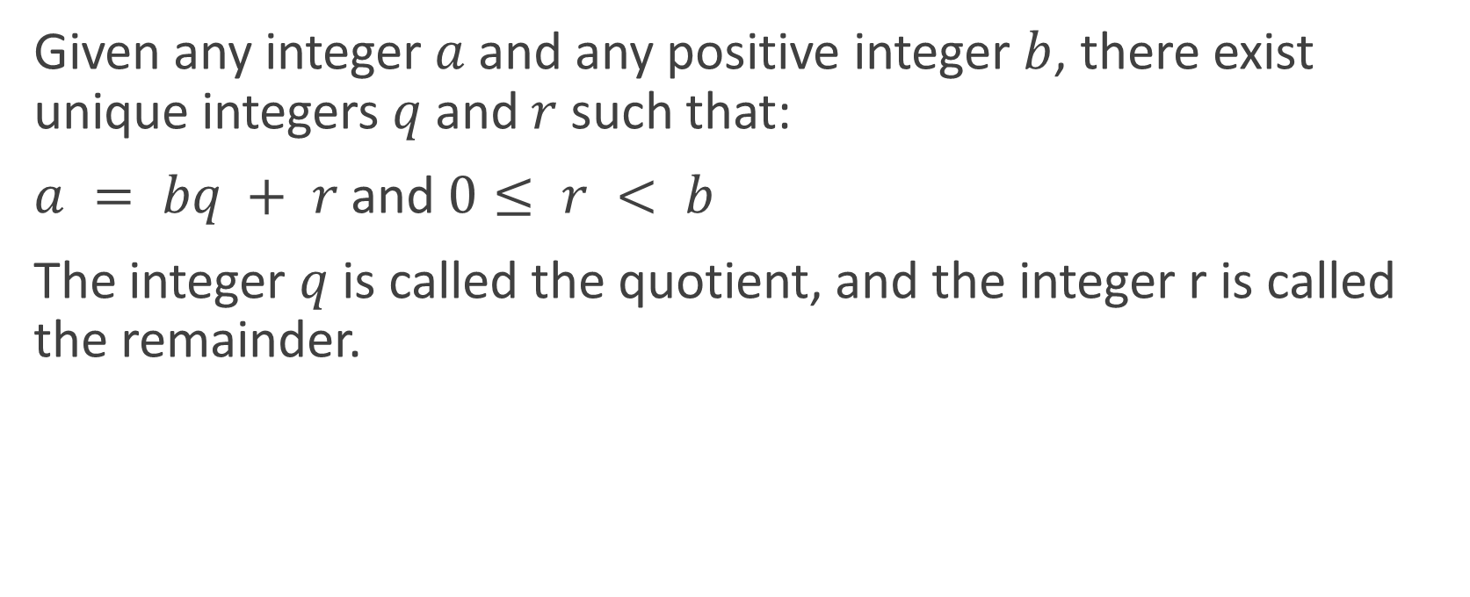
Quotient-Remainder Theorem
Given any integer$a$and any positive integer $b$, there exist unique integers$q$and $r$such that:
$a = bq + r$and $0≤ r < b$
The integer $q$ is called the quotient, and the integer r is called the remainder.

Slide 5
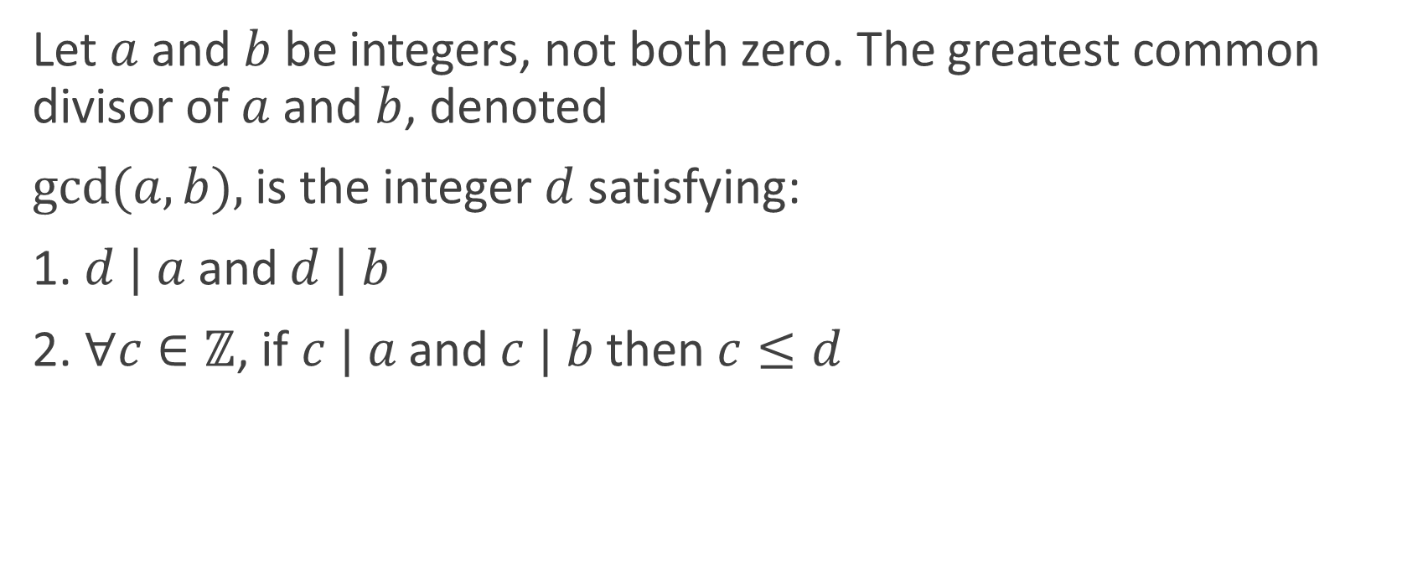
Greatest Common Divisor
Let $a$ and $b$ be integers, not both zero. The greatest common divisor of $a$ and $b$, denoted
$gcd⁡(a, b),$is the integer $d$ satisfying:
1. $d | a$and $d | b$
2. $∀c∈ℤ$, if $c | a$and $c | b$then $c≤d$

Slide 6
Euclid’s Algorithm
function gcd(a,b):
while b>0:
c = a%b
(a,b) = (b,c)
return a

Slide 7

Extended Euclidean Algorithm
1. Perform Euclid’s algorithm on $a, b$to obtain the gcd $d$
2. Work backwards to express $d$ in terms of the linear combinations of the quotients and remainders of the previous lines until we reach $a$ and $b$

Slide 8
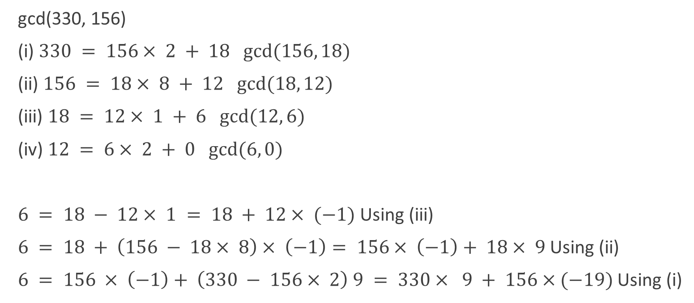
Extended Euclidean Algorithm
gcd(330, 156)
(i) $330 = 156× 2 + 18 gcd⁡(156, 18)$
(ii) $156 = 18× 8 + 12 gcd⁡(18, 12)$
(iii) $18 = 12× 1 + 6 gcd⁡(12, 6)$
(iv) $12 = 6× 2 + 0 gcd⁡(6, 0)$
$6 = 18 − 12× 1 = 18 + 12× (−1)$Using (iii)
$6 = 18 + \left(156 − 18× 8\right)× \left(−1\right)= 156× \left(−1\right)+ 18× 9$Using (ii)
$6 = 156 × \left(−1\right)+ \left(330 − 156× 2\right) 9 = 330× 9 + 156×(−19)$Using (i)

Slide 9
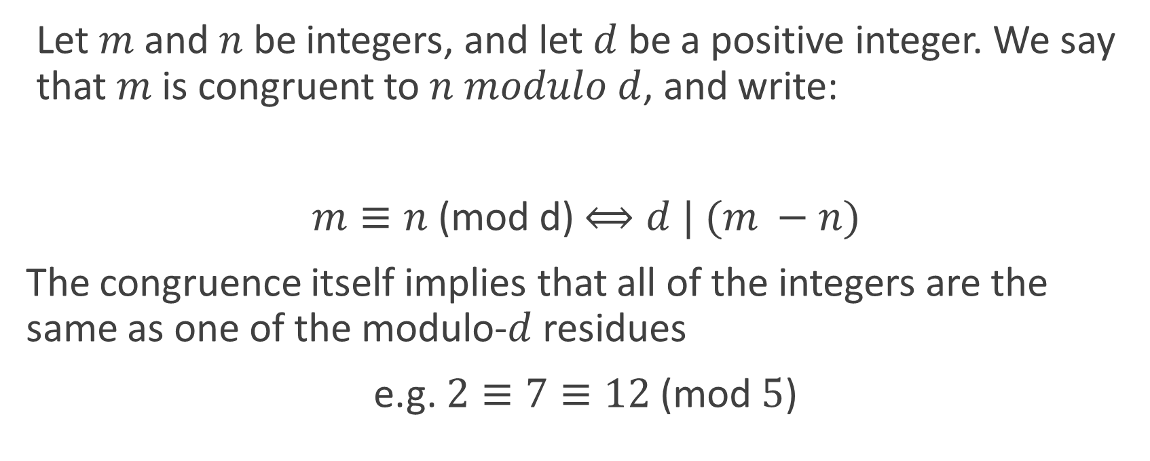
Modulo Arithmetic
Let $m$ and $n$ be integers, and let $d$ be a positive integer. We say that $m$ is congruent to $n modulo d$, and write:
$m≡n$(mod d) $⟺d | (m −n)$
The congruence itself implies that all of the integers are the same as one of the modulo-$d$ residues
e.g. $2≡7≡12$(mod $5$)

Slide 10

Modulo Inverses
For any integers $a, n$with $n > 1$, if an integer $s$ is such that
$as≡ 1$(mod $n$), then $s$ is called the multiplicative inverse of
$a modulo n$. We may write the inverse as $a^{−1}$.

Slide 11
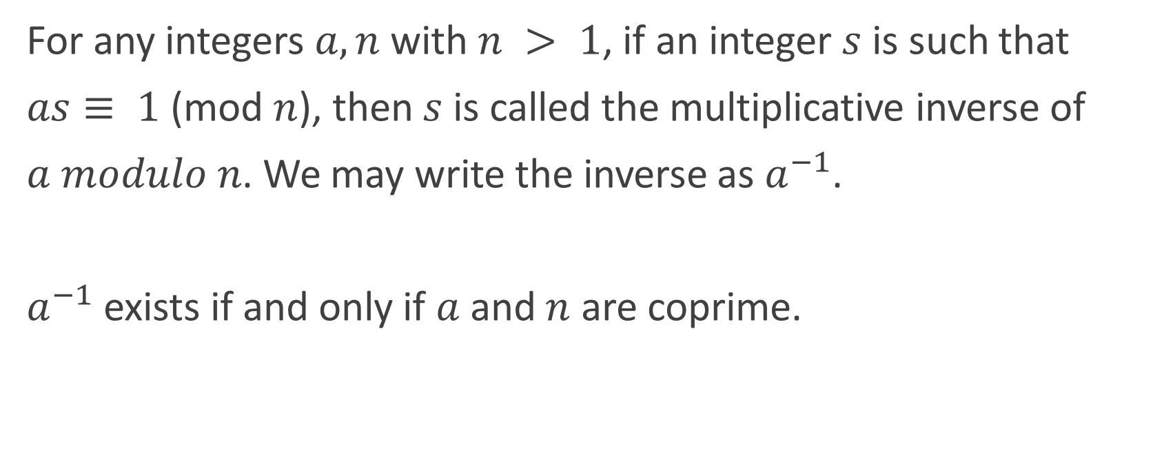
Modulo Inverses
For any integers $a, n$with $n > 1$, if an integer $s$ is such that
$as≡ 1$(mod $n$), then $s$ is called the multiplicative inverse of
$a modulo n$. We may write the inverse as $a^{−1}$.
$a^{−1}$ exists if and only if $a$ and $n$ are coprime.

